Slide 1



Data Analytics
Unit 7 - Storytelling with Data, Web Scraping, APIs, AB Testing
NOV - DEC 2020 | BERLIN

Slide 2
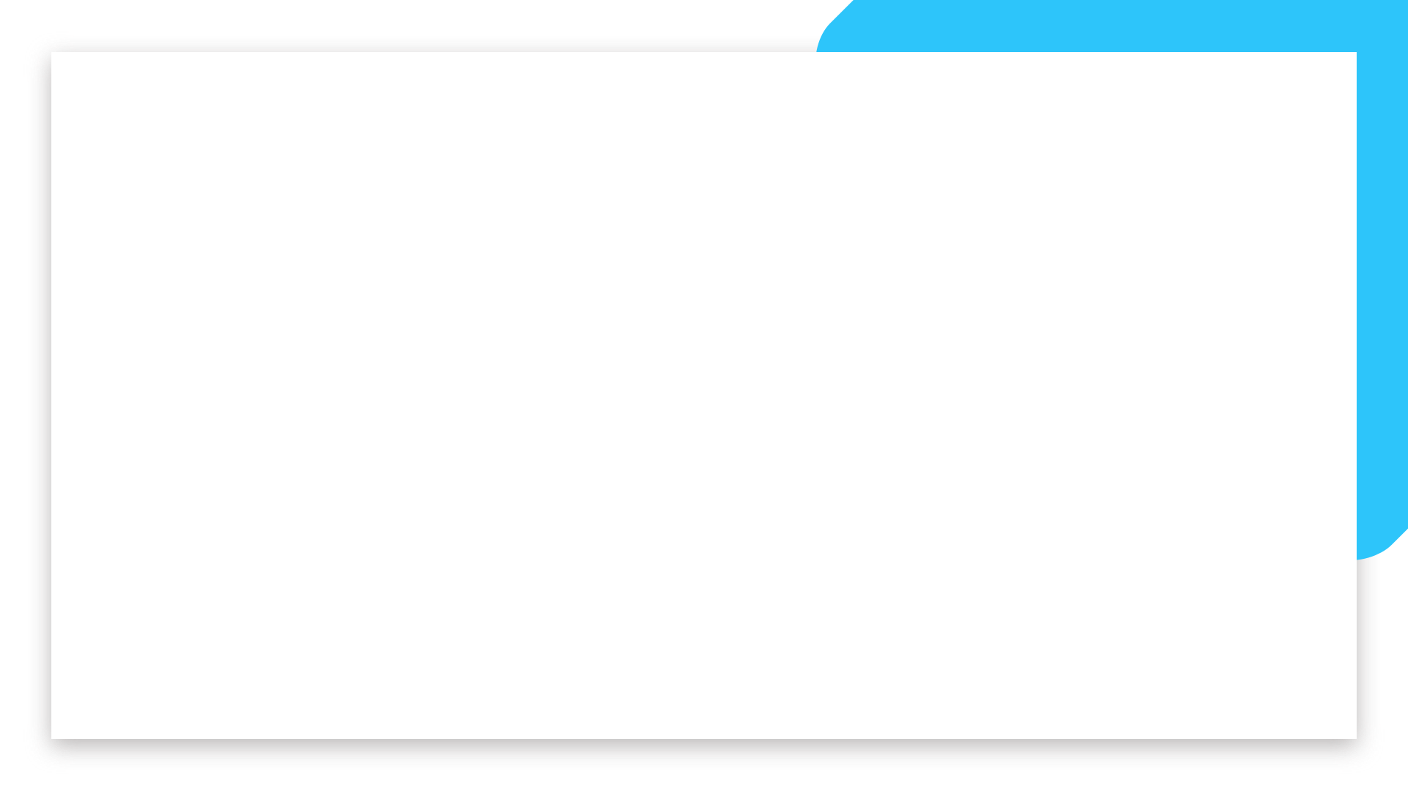
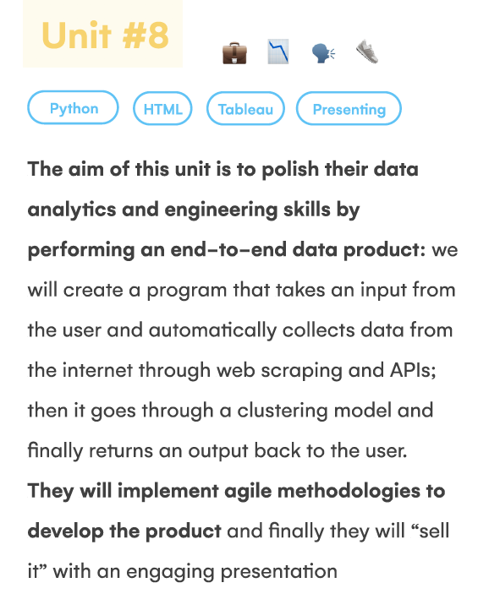
What will I learn in this unit?

Slide 3
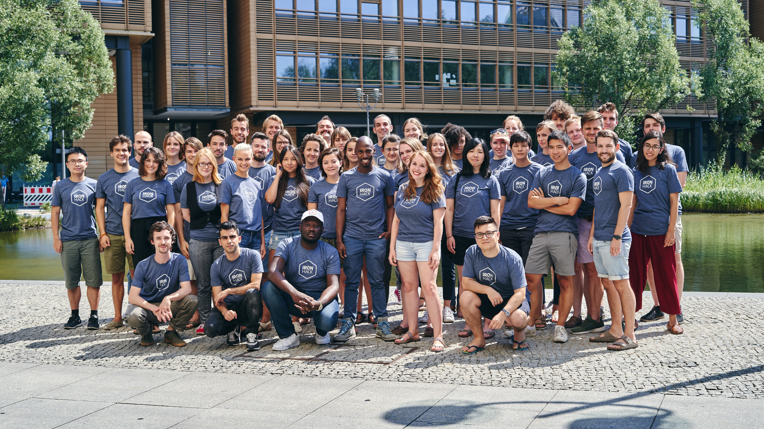

Fun day - Monday

Slide 4



Morning lecture
Afternoon Session
Gallery
Group Project
Covid-19 and Human Movement
4.30-4.45 Break
4.45 Gallery of Data Stories
LFB Best of class dashboards
Why do we tell stories?
Zoom in Zoom out
Data storytelling
Narrative Arc
Tips on Tableau Story setup
--Project intro--
(split into groups)

Slide 5
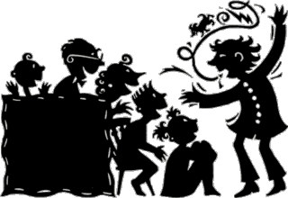
Why do we tell stories?
Value and meaning
Oldest tradition
Learn its important in childhood
To be remembered - emotion causes memory
Makes us human - relate the story of everything - how we relate to things- impact!
Connection - is a story - make something relevant - you feel involved
Communicate ideas - shared reality/ history
Tells you who you are
Explain our world
Distinctly human trait - religion, nationhood
Identifies us and other
Information - warnings - morality

Slide 6
What makes a good story?
Clarity
Visuals are vivid
Tone
Humour
Strength in storyline - peak
Structure
Common thread
Relatability
Shock , Surprise, unexpected
Elicit an emotional reactions

Slide 7

Zoom in Zoom out

Slide 8


Slide 9
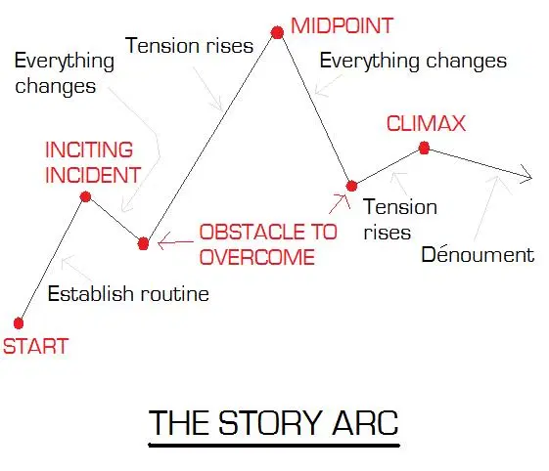

Slide 10
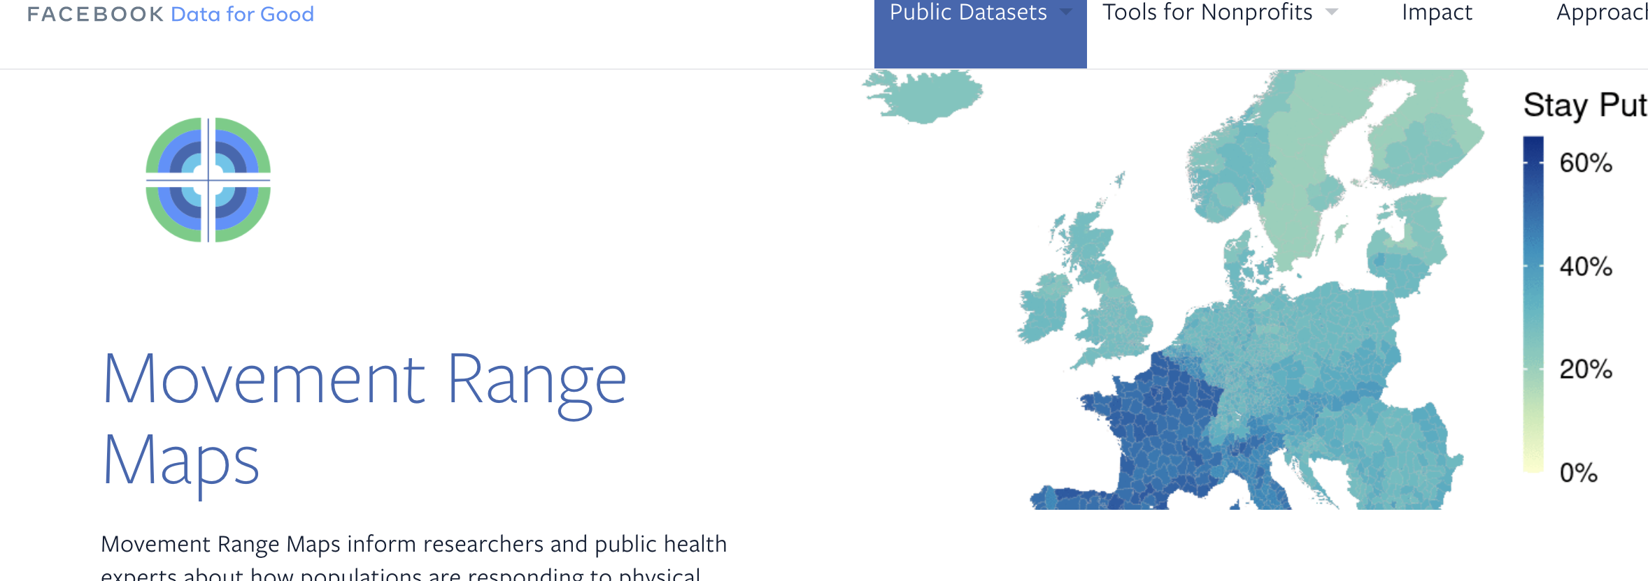

Slide 11
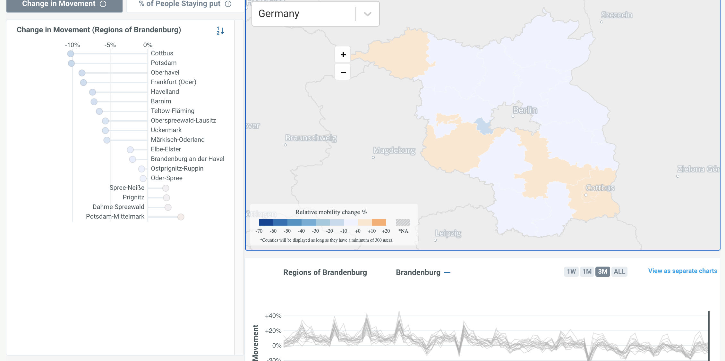

Slide 12
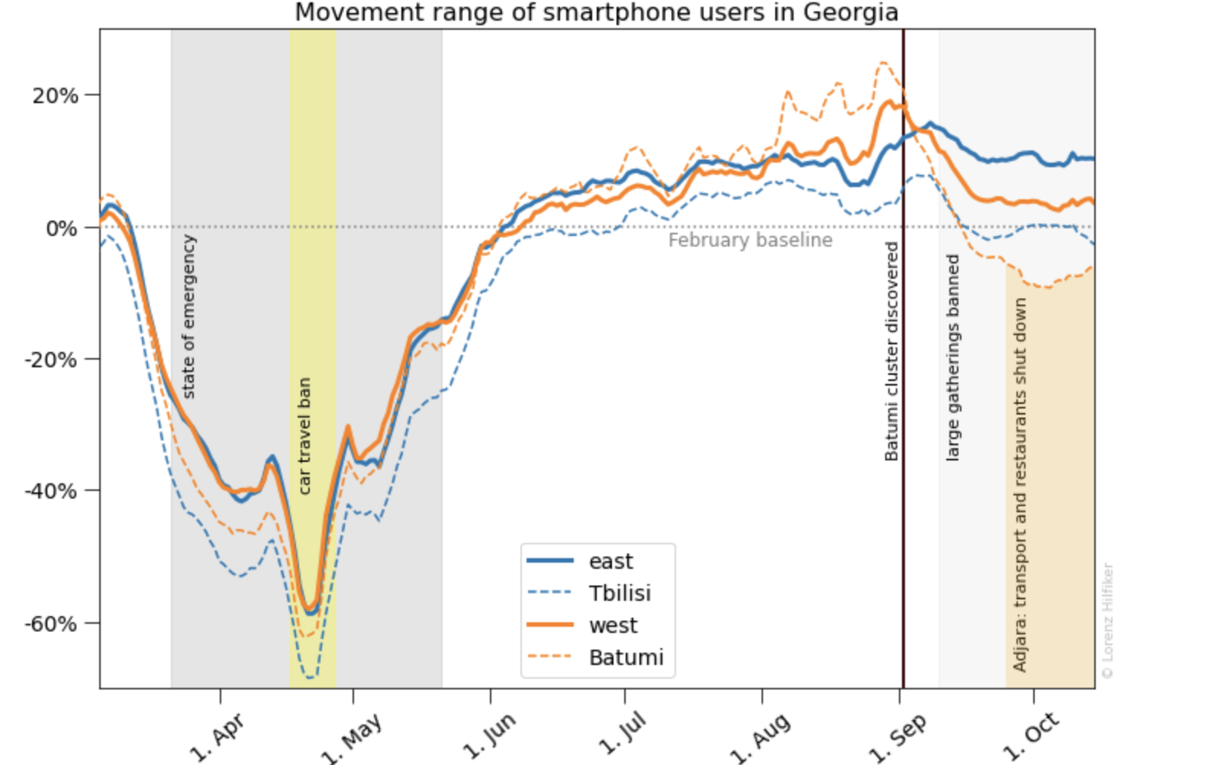

Slide 13

Two Day - Tuesday

Slide 14
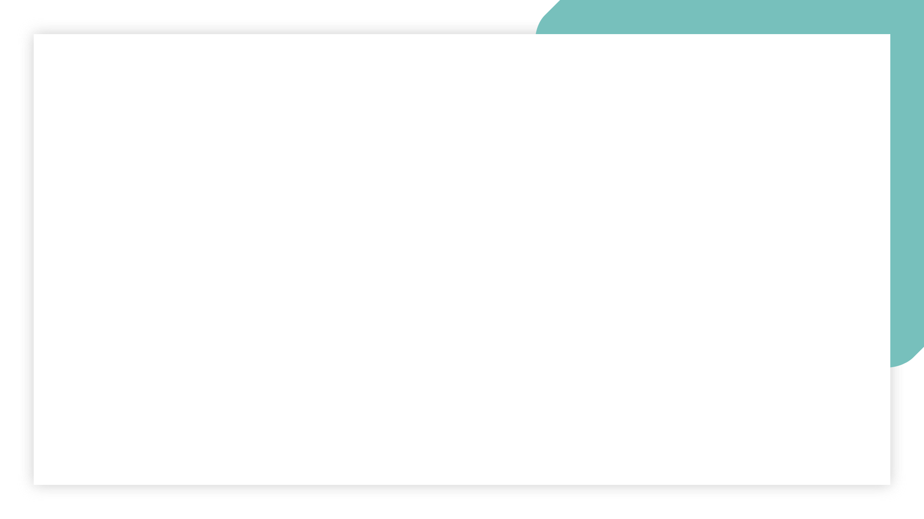

Morning session
Afternoon Session
Lab Session
Introduction to WebScraping
Case Study explained
When do we need it? 8.01.1
Html basics
Tags, structure, inspect
Next steps for newbies
Beautiful Soup & Parsing 8.01.2
Scraped data & pandas
Andres presentation- final project - and deep learning
Lunch 12:30 - 1:30
Review of Pandas and Getting started with Web Scraping with Flo
->TA assisted Labs from 15:00 -
8.01 (inside lesson unit in Day 2 of student portal) HTML Web Scraping
Web Scraping -optional
HTML Tutorial - optional
CSS Level 32 - optional

Slide 15
Project flowchart - GNOD Case Study
Yes
Recommend another “hot” song
Is it currently “hot”?
User inputs song
No
Recommend “similar” song

Slide 16


1st prototype
Data collection
“Hot” songs
Web scraping
Yes
Recommend another “hot” song
Is it currently “hot”?
User inputs song
No recommendation
No
Notes:
Show this on day 2

Slide 17
When to use web scraping
No API - if API is available, normally better to use it
Automation Needed - of course we can copy + paste but … ugh
Less Restricted - eg no API account required, less rules to follow (eg limit on # requests)
ISSUES
You depend on the structure of the site being scraped
Can be messy
Can change overnight
Website protections

Slide 18
When to use web scraping
Ideas for sites and use cases
Yellow pages - addresses of companies in a city
Reddit
Asos - images of menswear
Social networks
Amazon - prices of products
Bbc news - see how countries are described
Airbnb - apartments and room prices / sizes / locations - impact
Twitter - Bit coin all time high - look for acronyms
Skyscanner - demand forecasting - prices - best times to book
Linkedin - for filtering jobs
Web scraping slides

Slide 19
Basic html (tree) structure
<!DOCTYPE html>
<html>
<head>
<title>Page Title</title>
</head>
<body>
<h1>My First Heading</h1>
<p>My first paragraph.</p>
<p>My second paragraph has a <b>bold<b> word!</p>
</body>
</html>

Slide 20
An HTML element is defined by a start tag, some content and an end tag. When web scraping we will mostly be interested in the content, but the tag will be crucial in locating the content.
Tags are just keywords that encapsulate some content. They tell the web browser how to display the content. Some examples of common tags are:
<!DOCTYPE> and <html> define the document type
<head>, <title> and <body> define the main parts of the document
<h1> to <h6> define headings
<p> defines a paragraph
<b> will make its contents bold

Slide 21
Tags , attributes and value pairs
<a href="https://www.ironhack.com/">a data bootcamp</a>

Slide 22
Attributes you need to know
The id attribute: unless the creator of the site has broken basic conventions, id's are unique. That makes them the best attributes for locating data in a site. If you discover that the piece of information you're trying to collect is an element that has an id, your job will be SO EASY. Bad news though: that doesn't happen often.
The class attribute: it's often used to give style to multiple elements. For example, go to https://xkcd.com/. Notice how there are elements like "boxes" or "buttons" that are styled similarly in a site. Instead of defining the style for each one of these elements, the style for all the "boxes" might be defined in a different script (a CSS document), and it just points to all elements with class = "box". This is often a useful way to locate content inside of an HTML script.
Notes:
Understanding the HTML tree structure is key to web scraping, but that doesn't mean we should know what each tag or attribute is supposed to do. It might help to get the logic underlying that site, but ultimately we don't care much if the data we're looking for is under a <div> or a <li> tag, we just have to detect it and write the code that grabs it.

Slide 23
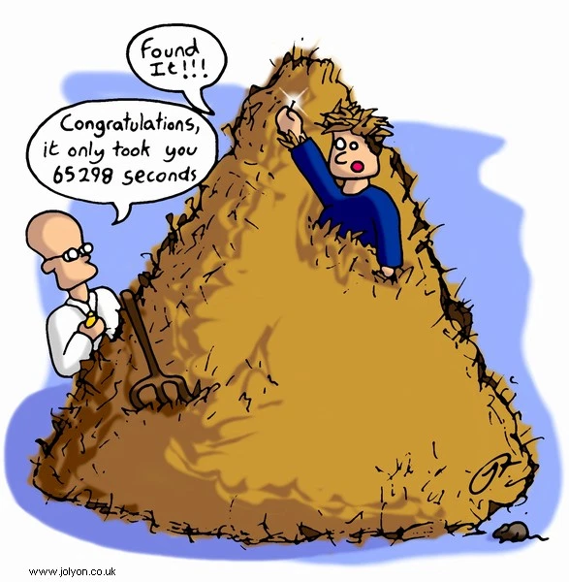

Slide 24
The dormouse’s story

Slide 25
Wikipedia - languages
Notes:
Cmd shift c _ elements _ hover over html code to see webpage light up
Mouse pointer on square top right to dynamically navigate from site to html and vice versa
Ignore the style content

Slide 26

‘Hump day’ Wednesday

Slide 27
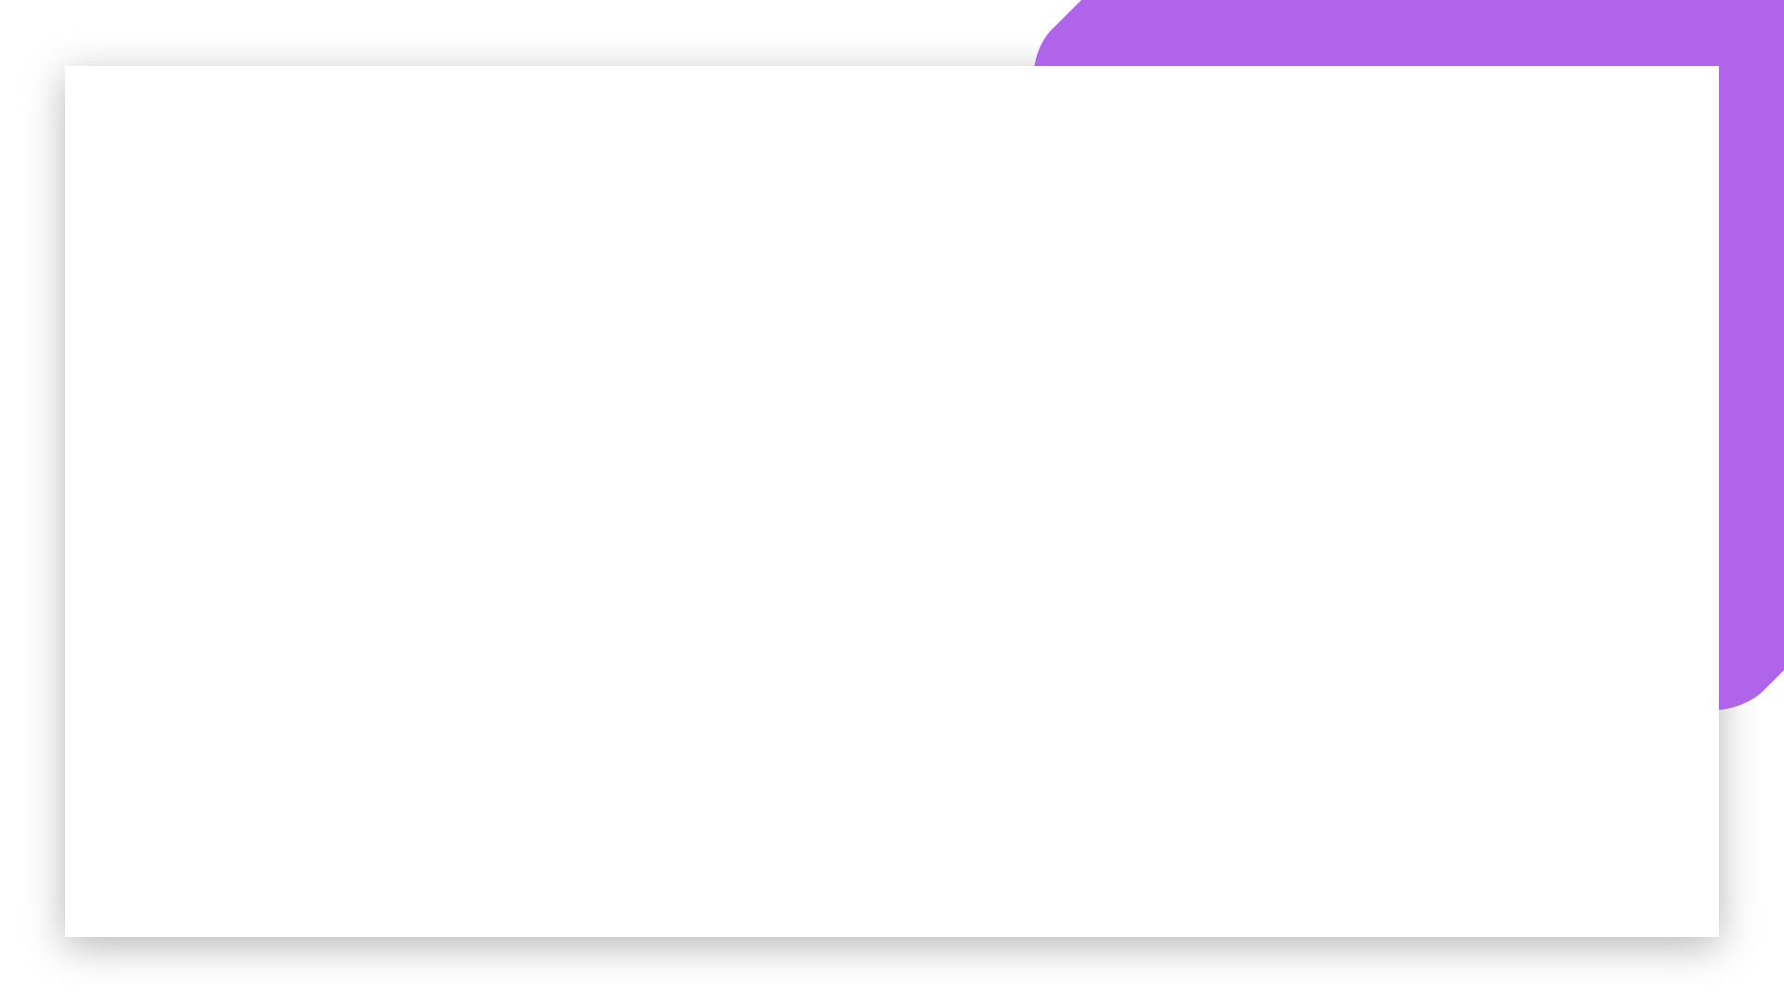
Morning session
Afternoon Session
Lab Session
1
Lunch 13:00 -
->TA assisted Labs from 15:00-

Slide 28

Nearly there Thursday

Slide 29

Morning session
Afternoon Session
Lab Session
Lunch 12:30 -
->TA assisted Labs from 16:00

Slide 31

TFI Friday

Slide 32
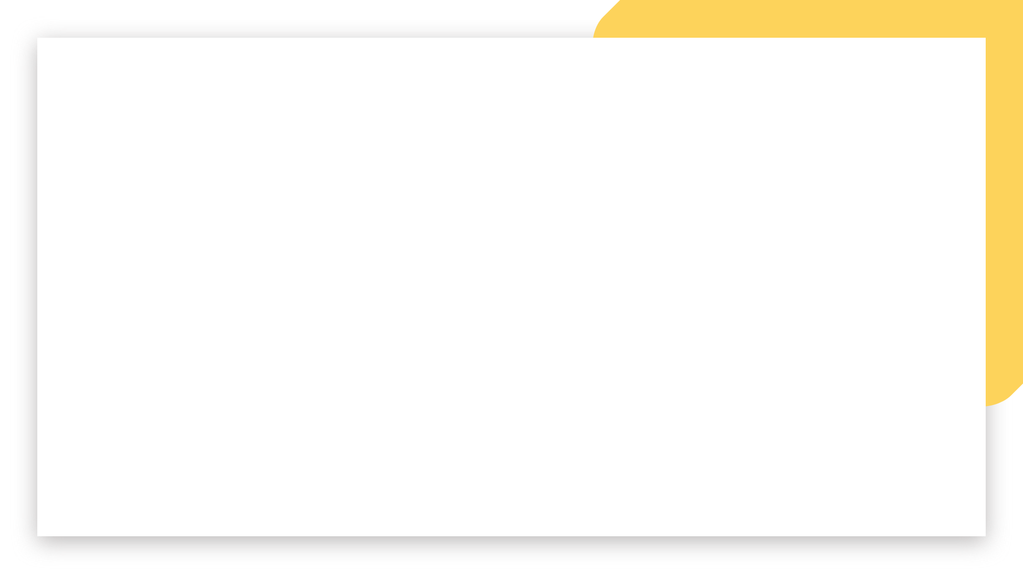
Morning session
Lunch 12:40 - 1:45
Afternoon Session

